Slide 1
SOCIAL DETERMINANTS of HEALTH

Slide 2
Facts
In 2004, Costa Ricans lived, on average, to the age of 77, almost identical to life expectancy in US. Yet US per capita income was more than four times that of Costa Rica.
In 2000, inhabitants of the southern India, earning, on average, less than US$ 3000 per year, had a life expectancy of 74.6, while Washington DC residents, with almost $30000 per capita annual income, had a life expectancy of 72.6!
Why?

Slide 3
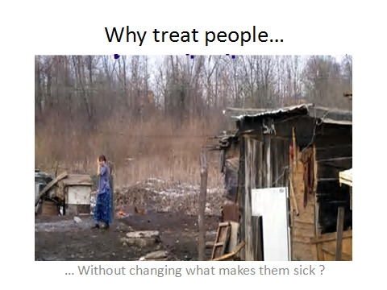

Slide 4
Social determinants of health
The social determinants of health are the conditions in which people are born, grow, live, work and age, including the health system.

Slide 5
Social determinants of health
These circumstances are shaped by the distribution of money, power and resources at global, national and local levels, which are themselves influenced by policy choices. The social determinants of health are mostly responsible for health inequities - the unfair and avoidable differences in health status seen within and between countries.

Slide 6
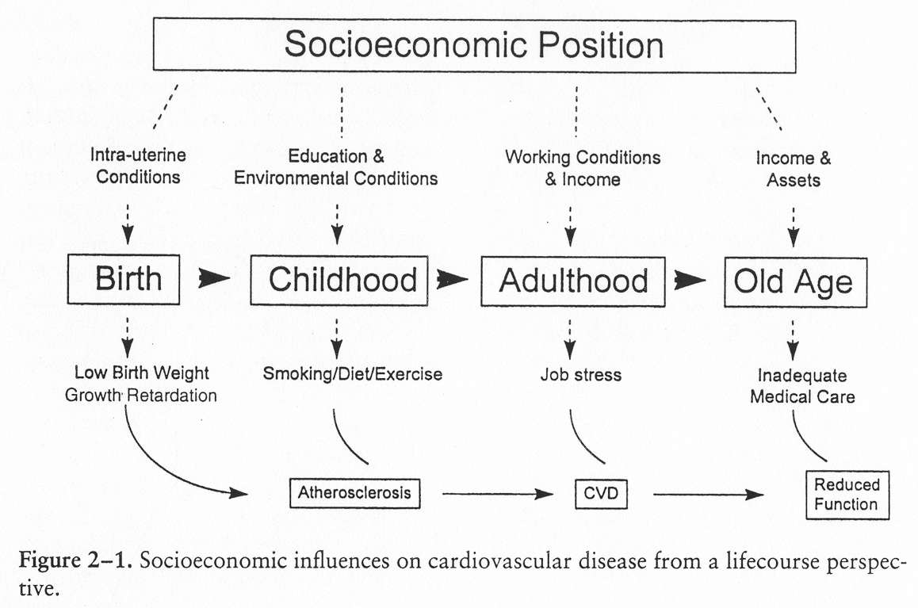
SDH are multi-sectoral and influences are throughout lifespan

Slide 8
Themes underpinning SDH
Health equity
The absence of systematic disparities in health (or its social determinants) between more or less advantaged groups, or geographical areas.
The right to health
“The enjoyment of the highest attainable standard of health is one of the fundamental rights of every human being without distinction of race, religion, political belief, economic or social condition.”
Notes:
تشكيل زيربنا :underpinning

Slide 9
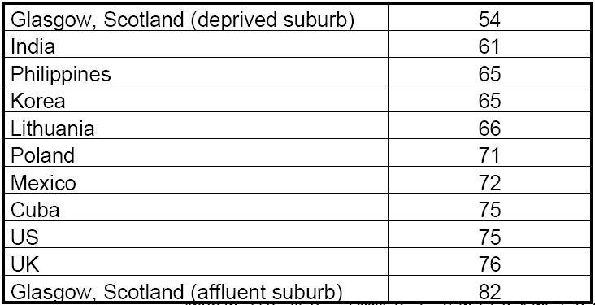
Life expectancy at birth (men)

Slide 10
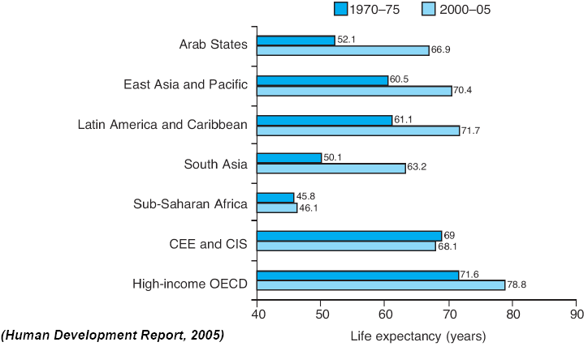
Trends in life expectancy
Notes:
CEE: Central Eastern Europe, CIS: Commonwealth of Independent States
OECD: Organization of Economic Cooperation and Development .

Slide 11
Under 5 mortality per 1000 live births by wealth quintile

Slide 12
Inequities in health outcomes in countries of EMR/MENA
Notes:
"Middle East and North Africa” MENA:

Slide 13
Regional trend in adult literacy in the Region, 1980–2007

Slide 14
Antenatal Care Coverage by
Female literacy arte

Slide 15
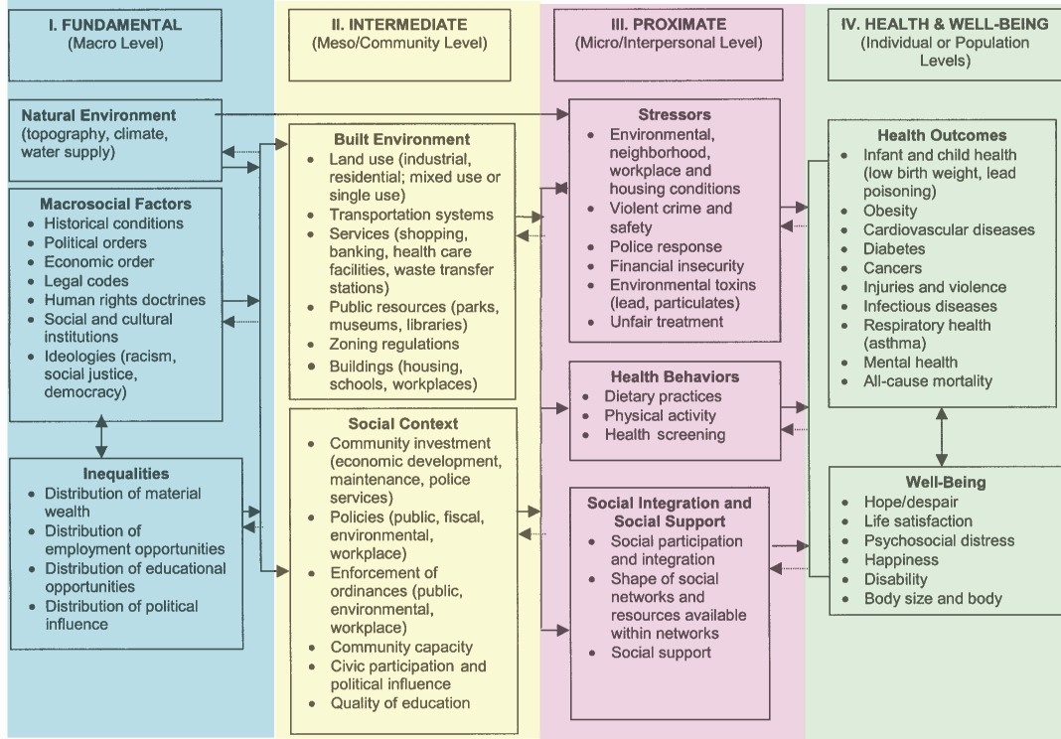
Conceptual Framework

Slide 16
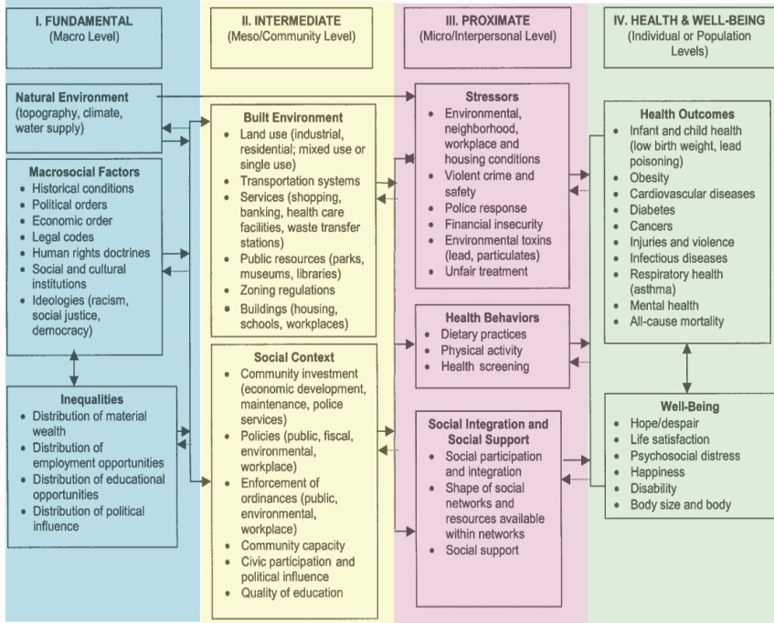
Conceptual Framework
Notes:
بيواسطه

Slide 17
Notes:
دستورالعمل

Slide 18
Notes:
آئين نامه هاي اجرايي

Slide 21
Quiz
Choose a health status condition or illness in your field of work and describe influential effects of social determinants of health on your chosen condition.

